Slide 1
A Personal Historical Perspective on Systems Studies at Binghamton & Elsewhere
CoCo Seminar
March 2, 2016
Hal Lewis

Slide 2
Overview
Reasons for knowing some history
Subtext: A matter of identity
Origins of systems studies
Early days of systems studies at Binghamton: SAT
My personal experiences leading me to systems science
Systems science at Binghamton in the ‘80s
Systems science in other locations
What has happened since then?
Personal reflections & possible lessons

Slide 3
Reasons for knowing some history
To discover potentially useful ideas to pick up & develop anew
To put our current ideas & activities into context
To understand what’s really going on now, we need to understand what went on before
To avoid past mistakes
To have a basis of communication with people from the past (alumni, past faculty, etc.)
Pride/Marketing on past glories
BUT NOT to attempt to recreate the past

Slide 4
Subtext: A matter of identity
I’ll be upfront in telling you one of my subtexts—Identity issues are important
I don’t identify myself as an engineer
I don’t identify systems science as primarily an engineering field
When we’re misidentified by others or ourselves, we miss opportunities & we suffer

Slide 5
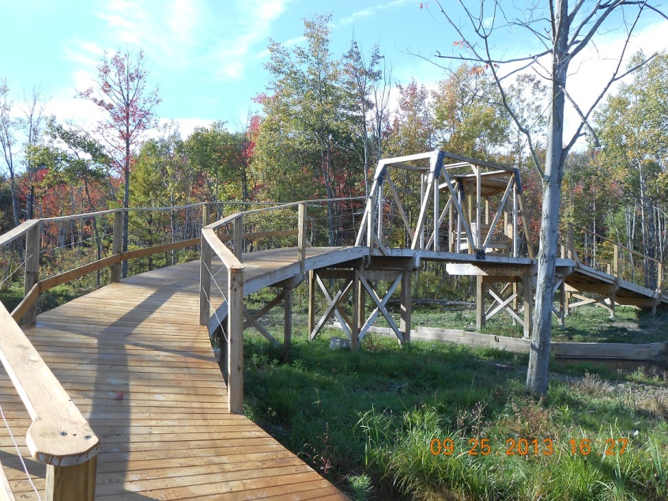
Subtext: Not that I’m anti-engineering

Slide 6
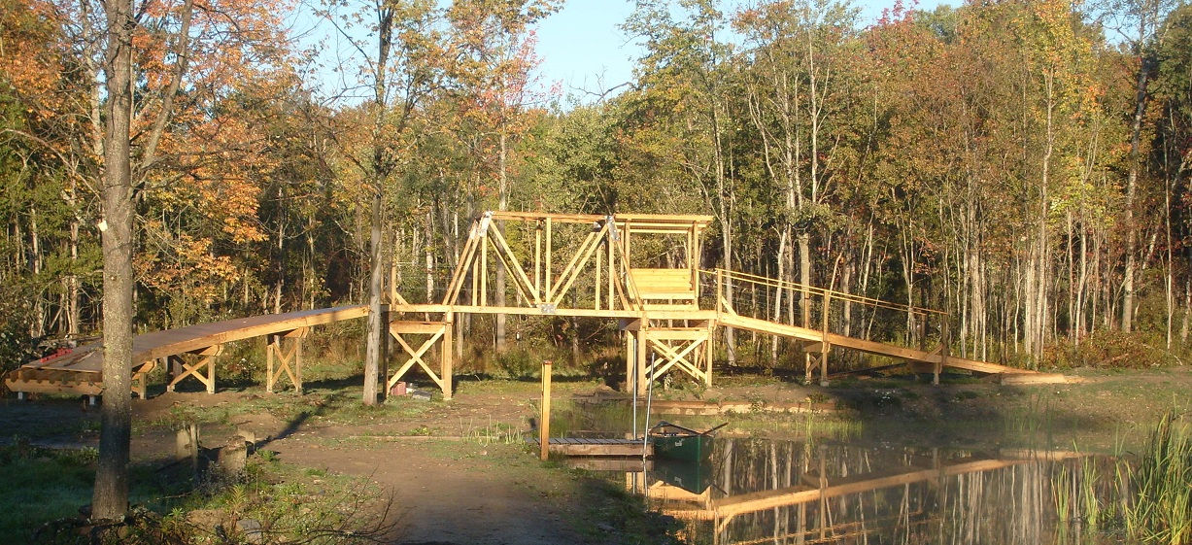
Subtext: Not that I’m anti-engineering

Slide 7
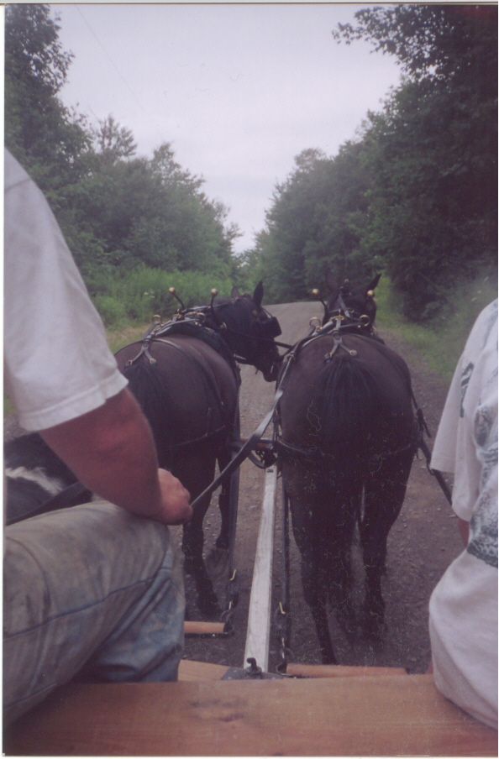
Subtext: But there is a lot more than engineering

Slide 8
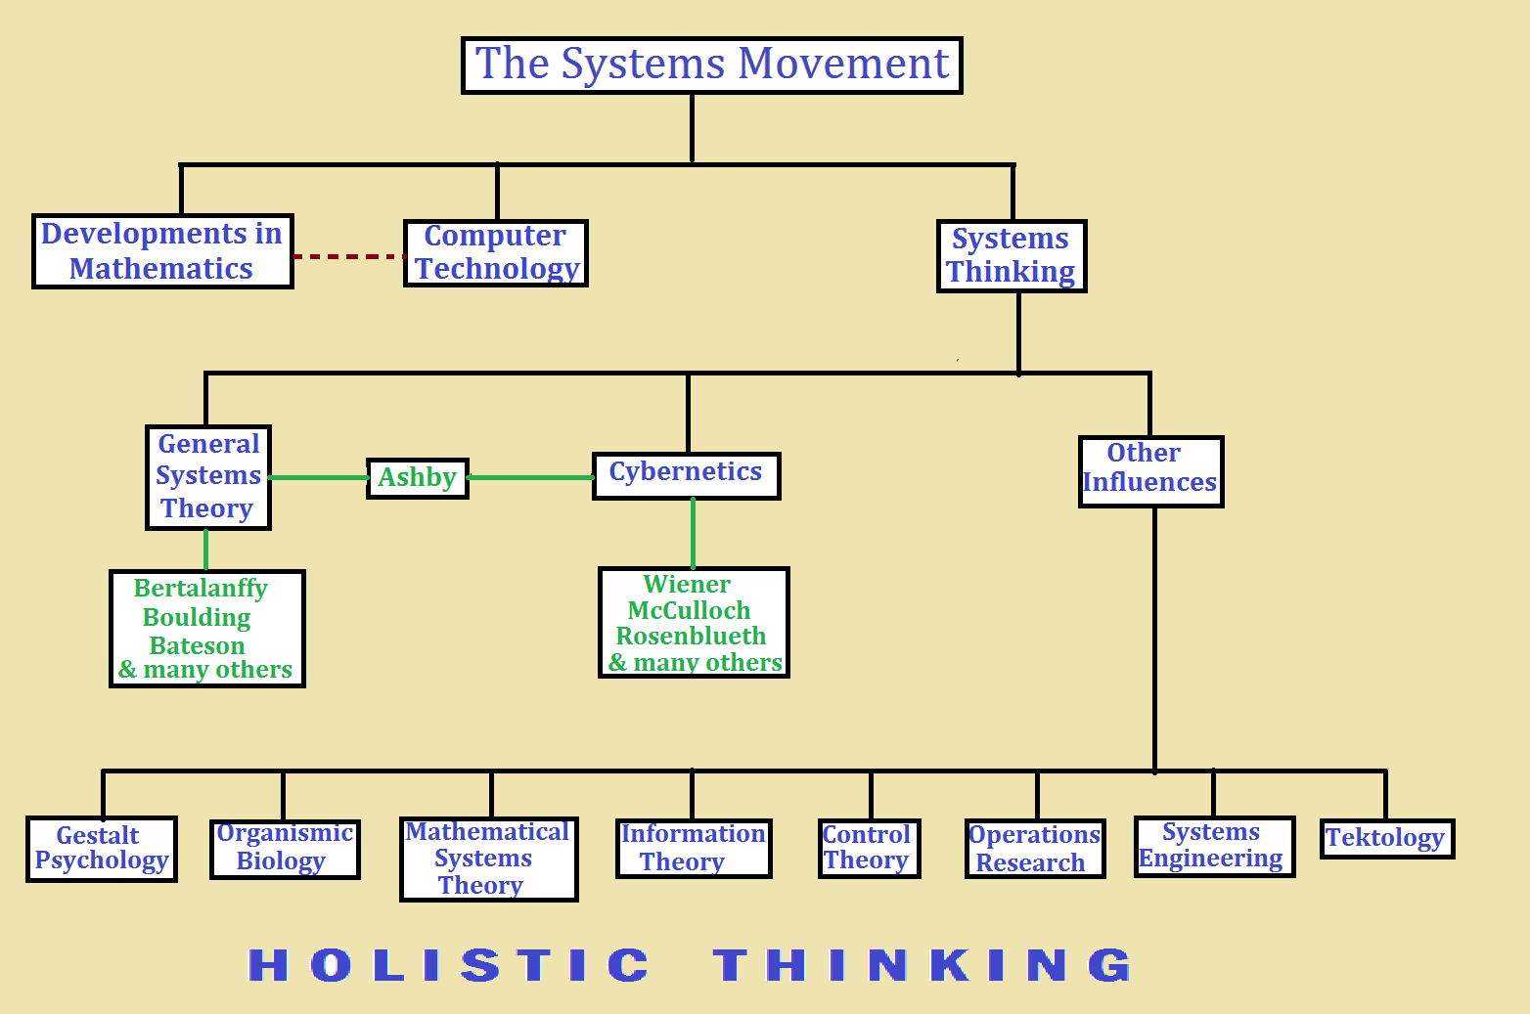
Systems studies origins

Slide 9
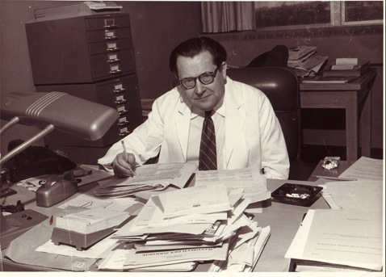
Systems studies origins
From EMCSR website:
Looking back…Systems Theory and Ludwig von Bertalanffy
“Ludwig von Bertalanffy was
an Austrian-born biologist
and system theorist, who left
behind a precious legacy: a
new way of ‘seeing’ and
thinking that he called
General Systems Theory.”
Copyright: Bertalanffy Center for the
Study of Systems Science

Slide 10
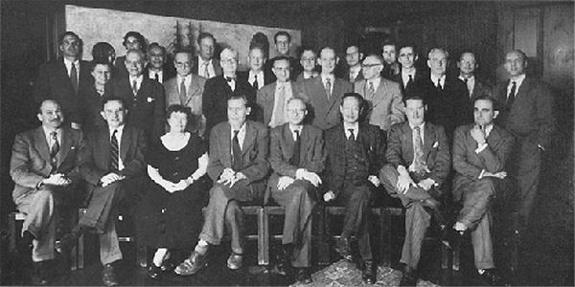
Systems studies origins
The Macy Conferences (1946 – 1953, Manhattan)
  “They are also considered as the breeding ground for Cybernetics and breakthroughs in Systems Theory. In essence, they brought ‘systems thinking’ to the awareness of a cross-disciplinary group of intellectuals.”*
William Ross Ashby (psychiatrist), Gregory Bateson (anthropologist), Julian Bigelow (computer engineer), Heinz von Foerster (biophysicist), Lawrence K. Frank (social scientist), Ralph W. Gerard (neurophysiologist), Molly Harrower (pioneering clinical psychologist), Lawrence Kubie (psychatrist), Paul Lazarsfeld (sociologist), Kurt Lewin (psychologist, often regarded as the founder of social psychology), Warren McCulloch (psychatrist, neurophysiologist and cybernetician), Margaret Mead (cultural anthropologist), John von Neumann (mathematician), Walter Pitts (logician), Arturo Rosenblueth
(physician, physiologist and a pioneer of
cybernetics), Leonard J. Savage (mathematician),
and Norbert Wiener (mathematician and founder
of cybernetics) * From emcsr website

Slide 11
Systems studies origins
EMCRS (European Meetings on Cybernetics and Systems Research, in Vienna since 1972, organized by the Austrian Society for Cybernetic Studies & the International Federation for Systems Research) were founded by the pioneers of GST and cybernetics, and viewed as successors to the Macy Conferences
George Klir & other people from Binghamton participated heavily in the early years
George had a major following there
George conducted an informal survey concluding that Ashby is the most influential of all systems theorists

Slide 12
Some definitions & claims of Klir
Interdisciplinary: Fields on the border of (typically two) disciplines (biochemistry, social anthropology, geophysics, etc.)
Multidisciplinary: Fields where it is useful to build teams of people from multiple fields to address the complex problems of a specific application area (sustainable communities, public health, robotics)
Transdisciplinary: Fields of such a fundamental nature as to have major significance to all (or nearly all) other disciplines (systems science)
Whereas most of science focuses on a “thinghood” domain, systems science focuses on “systemhood”

Slide 13
Early days of systems studies at Binghamton
Think back to the mid-60s, Harpur was SUNY-B
1967: School of Advanced Technology started as 1st professional school at Binghamton
Walter Lowen (Nuclear Engineering/Swiss Federal Institute-Zurich) hired as dean
Walt’s vision: To have a systems school (not an engineering school)—to bring in brilliant minds from diverse systems backgrounds
Started with important connections to Systems Research Institute in Manhattan (&Geneva?) in terms of overlap in faculty, influence in content & format

Slide 14
Early days of systems studies at Binghamton
1967: 1st (evening) classes taught by adjuncts from IBM & GE, including Don Gause & Walt Niehoff, to about 100 graduate students (all part-time, about 80% employees of IBM, GE, Link, Corning, Bendix)
1968: SAT officially established, First regular faculty hired including Don Gause & Gerry Weinberg
1969: More regular faculty hired, including George Klir, Herb Hellerman (major player at SRI & in developing IBM 360 architecture & APL), Joe Cornacchio
1969-1972: First version of program becomes clearly established

Slide 15
Early days of systems studies at Binghamton
SAT not yet departmentalized & only certified to offer graduate degrees in “Advanced Technology”, with 3 concentrations:
  Applied mathematics
  Computer systems
  General systems
  (Avoided using “science” as parts of names, because names containing “science” are not really science)
Still determined to be a graduate-only program with MS and some PhD degrees
Continue to be many adjuncts from local industry & joint appointments from Math Dept.

Slide 16
Early days of systems studies at Binghamton
Walt Lowen & others firmly believed SAT should be open to students from all undergraduate backgrounds
Foundations program (remedial courses for students from non-mathematical backgrounds) 6 (2 credit) courses on videotape:
  Numerical analysis
  Logic & Boolean algebra
  PL/I
  APL
  Probability & statistics
  Set Theory

Slide 17
Early days of systems studies at Binghamton
Quotes from Walt Lowen:
“. . . The administration, all products of the Liberal Arts tradition steeped in Literature, Art, and Social Science were perplexed. They were rightfully proud of the reputation earned by young Harpur College. Their main concern was how could they respond to all these technological pressures without destroying the Liberal Arts. . . .The only strategy that occurred to me was to sell the idea of creating an interdisciplinary, futures-oriented, graduate-only school, with broad programs built strongly on the foundations of the Liberal Arts. And they liked that idea and so I went to work. I hired a futurist, John McHale. I hired some outstanding people in computing and brought in a psychiatrist to deal with ‘creative aspects of the unconscious,’ and I hired George Klir. . . .”*
*George J. Klir & Walter Lowen (1991), “Department of Systems Science at the State University of New York at Binghamton”, Int. J. of General Systems 19:1, 31-46.

Slide 18
Early days of systems studies at Binghamton
Quotes from Walt Lowen:
“The school was founded on the principle that admissions to graduate studies in SAT required a bachelor degree from any field. There were those who fought that- they wanted students whose preparation was defined and predictable. But the systems science cluster was genuinely attracted to young minds trained in music, anthropology, biology, mathematics, literature, etc. etc. The role of the students should not be underestimated. This unique climate attracted exceptionally bright students, who needed elbow room and felt alienated by traditional discipline boundaries. There is no doubt that they trembled at the thought of studying mathematics and programming, but the faculty rose to the challenge. They devised courses which made it possible to learn in a supportive setting where backgrounds were disparate. As these students approached the end of their formal studies, a fascinating merging of disciplines occurred in all of them. Not only was mathematics and science no longer frightening, they discovered connections to their own disciplines. They, far more than we, the faculty, became the true systems thinkers..”*
*George J. Klir & Walter Lowen (1991), “Department of Systems Science at the State University of New York at Binghamton”, Int. J. of General Systems 19:1, 31-46.

Slide 19
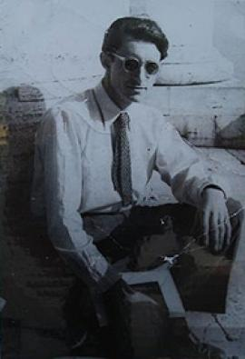
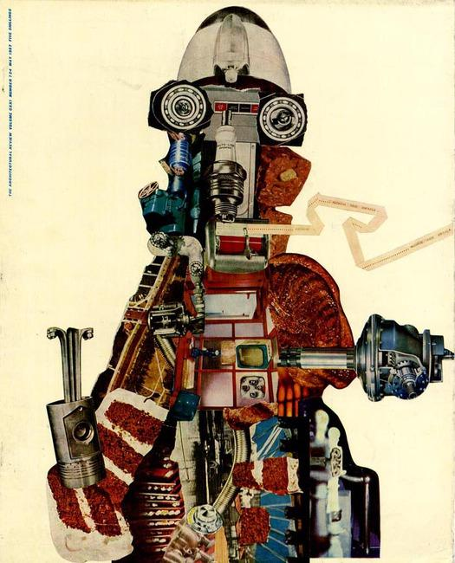
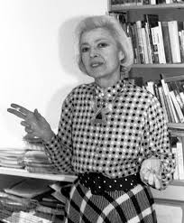
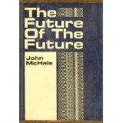

Early days: Some interesting people teaching in SAT
John McHale (British artist/futurist/sociologist)
  May have coined the term “pop art”
  Worked with Buckminister Fuller
  With wife, Magda Cordell McHale (also futurist & artist) lived in Binghamton 1968-77
  Together they started Center for Integrative Studies as part of SAT
  Completed his PhD in sociology while at Binghamton ?
  Convened a major international conference of futurists (Including Toffler & ?Fuller) in Binghamton
  Published best known books while at Binghamton

Slide 20
Early days: Some interesting people teaching in SAT
Stefan Bauer-Mengelberg (mathematician/ conductor/lawyer)
  Was once assistant conductor (under Leonard Bernstein) of NY Philharmonic
  Was once president of Mannes College of Music
  While a mathematician at SRI invented Ford-Columbia musical notation (a way to represent music in a computer)
  Taught probability and statistics class, logic, Boolean algebra, etc. for SAT
  Was highly effective in teaching mathematical topics at a high level to people with limited backgrounds
  Partly because of his influence, SAT developed a strong link to Harry Lincoln in the Music Dept.

Slide 21
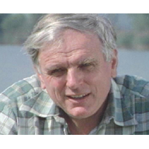
Early days: Some interesting people teaching in SAT
Dieter Baumann, MD (Jungian psychiatrist)
  Grandson of Carl Jung
  Among first people hired by Walt Lowen
  Taught courses from 6 weeks to a full semester at Binghamton
  Brought a distinctively Jungian psychology-based influence to SAT as a basis of problem solving & cognitive modeling
  Especially influential on Walt Lowen
  & Don Gause
  (Don later taught a few summers at
  CG Jung Institute-Zurich)

Slide 22
Early days: Toward the mid-70s
Plan to hire as a (bio-systems) trio from Buffalo: Robert Rosen, Howard Pattee, Narendra Goel, but Rosen backed out & went to Dalhousie instead
Some intra-school strife: Weinberg starts HST (Human Sciences & Technology) & Hellerman starts SST
Engineering (originally Professional) Bldg. designed 72-74, moved in in 76
Some in Harpur still distinctly anti-SAT combined with NYS budget crises led to many financial & other challenges

Slide 23
Early days: Late-70s to Early-80s
School departmentalized (1976):
  Computer systems concentration → CS Dept., Joe Cornacchio as chair
  General systems + applied math → SS Dept. George Klir as chair
Walt Lowen steps down as dean to teach in SS Dept.
John Colligan becomes acting dean 1976?-1981
Michael McGoff acting dean 1981-83
Local industry/Cliff Clark’s “High Tech Council” declare need for a “real” engineering school & put in motion process leading to Watson School

Slide 24
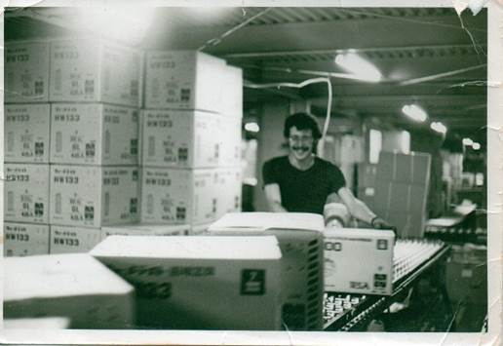
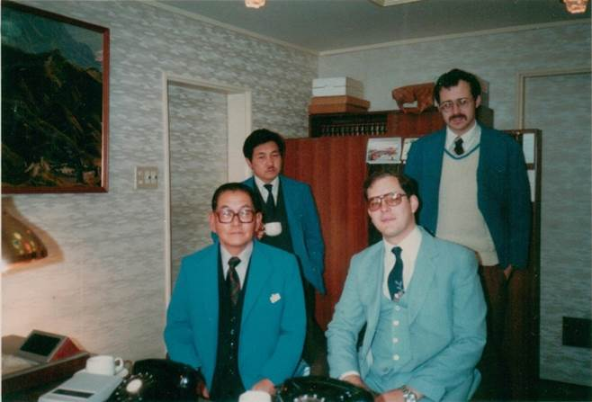
Personal Experiences leading me into systems science
1977-81: Had the most interesting job in the world at Kuroi Electric Co., Ltd. in Kyoto (with other plant in rural Tamba), a company of about 550 employees

Slide 25
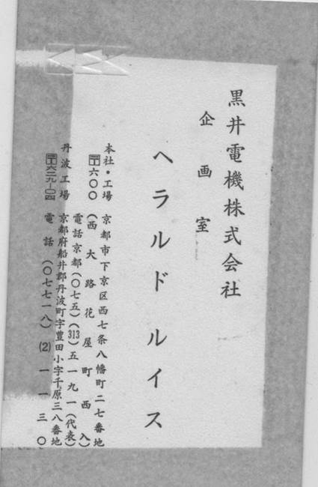
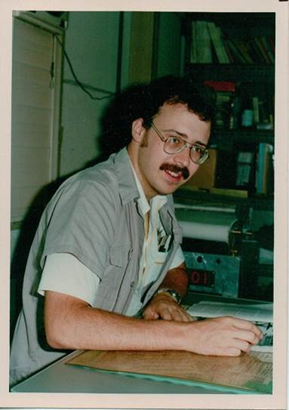
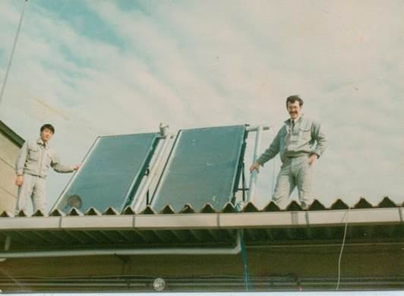
Personal Experiences leading me into systems science
A very special workplace: the 企画室

Slide 26
Amazing workplace: 企画室
Small team (about 3% of the company) developing all sorts of products: pollution control, solar, wine, etc., etc.
Incredible teamwork
Opportunities to learn so many things: heat transfer, control systems, alternative energy market, marketing, economics, finance, creativity, μ−processors, etc.
Two of my main roles: calculations & syst. design
Brainstorming & creativity
Hands on work: building prototypes, taking measurements, planting grapevines, making wine, etc. Even used Japanese typewriter
Interpreter/tour guide
Reading & summarizing business/technology literature
Attending & summarizing lectures, conventions, etc.
Market surveys/Sales calls

Slide 27
Personal Experiences leading me into systems science
Systems sciencey take-aways from time at Kuroi Electric:
  Calculations are a big deal
  Knowing in detail how to calculate something
  + Understanding why we calculate that way
  Truly understanding that object/process
  Great teamwork makes it fun to go to work
  Creative problem solving is a blast
  Personally, I’m addicted to variety: prefer to be a generalist in applying analytical skills

Slide 28
Personal Experiences leading me into systems science
Returned to US in late 1981—difficult readjustment
Soon join IBM-Endicott, but struggle with overcoming boredom → Part-time graduate study becomes all the more attractive
Accepted into MA in Economics Program & take micro-theory course with Ken Greene—did great & really loved it (found parallels to math)
However, strictly practical considerations left me with concerns about continuing with that degree
Met Jim Geer about that time when he was doing a short course for IBM & learned about Systems Science Program, soon decided to apply

Slide 29
Syst. Sci. at Binghamton in the ‘80s
June 15, 1983:
  SAT becomes the Watson School
  Lyle Feisel assumes role of dean
  Michael McGoff becomes associate dean
Philosophy of the school becomes almost the antithesis of what it previously was: Feisel saw his mission as transforming this into a typical engineering (& CS) school
A complex interaction evolves between Feisel & Klir

Slide 30
Syst. Sci. at Binghamton in the ‘80s
Fairly large & stable student population drawn from 2 main sources:
  Part-time, local students, mainly from industry (especially in MS Program)
  Full-time students from around the world drawn by interest in novel program or specific professor (despite limited funding opportunities)
Typically 6 or 7 full-time faculty members & a few adjuncts

Slide 31
Syst. Sci. at Binghamton in the ‘80s
Faculty research foci, curriculum content, & thesis topics generally eclectic, somewhat lacking in central focus
Large percentage of evening classes
Little emphasis on research funding
Productivity in publications high but varied
Strong tendency toward multidisciplinary connections especially with Harpur (most thesis & dissertation committees had at least one member from Harpur)
Somewhat more interaction with CS Dept. than was true later

Slide 32
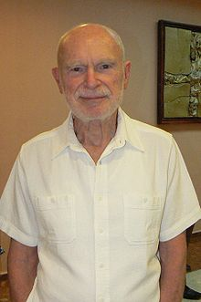

Syst. Sci. at Binghamton—Faculty
George Klir: Our systems
science superstar
  Czechoslovak Academy of Sciences
  Authored, coauthored, or edited
  approx. 40 books, many of which
  had truly major international
  significance
  Major following internationally &
  appointed Distinguished Professor of
  Systems Science in 1984 when
  distinguished professors were rare

Slide 33
Syst. Sci. at Binghamton—Faculty
George Klir (cont.):
  Formative experiences early in his career recognizing “profound similarities” between systems problems in many disciplines led to decades-long quest to form his own approach to a general systems framework: GSPS
  Deeply interested in philosophy of science & systems
  Began placing major emphasis on fuzzy logic during 1980s shifting more toward nonadditive measure theory in the ‘90s
  Pioneered mathematical field: Reconstructability Analysis
  Pioneered second mathematical field: Generalized Information Theory (GIT)
  His focus has often been more on fundamentals than on applications
  Can we pick up some of his work and apply it?

Slide 34
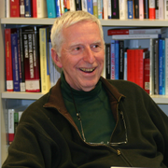
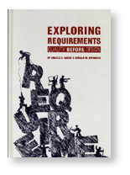
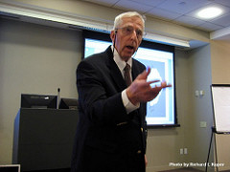
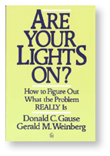
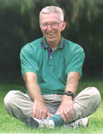
Syst. Sci. at Binghamton—Faculty
Don Gause:
  Michigan State University—Mathematics
  One of the very first to teach for SAT
  Prior experience in GM & IBM (including managerial experience in employee education)
  Taught amazing course on creativity in problem solving
  Also taught systems design, “requirements engineering”, adaptive programming

Slide 35
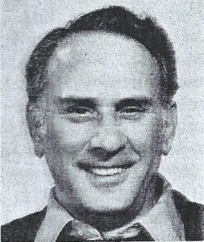
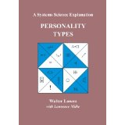
Syst. Sci. at Binghamton—Faculty
Walter Lowen:
  Swiss Federal Institute—Nuclear Engineering
  Another very creative & innovative person
  After stepping down as original dean, taught in
  SS Dept. & decided to shift his core research
  focus to connections of psychology to systems science— problem solving, modeling of cognition, &
  systems design
  Courses taught: “Visual Thinking” &
    “The Psychology of Problem Solving”
  Books: Dichotomies of the Mind: A Systems
  Science Model of the Mind and Personality &
  Personality Types: A Systems Science Explanation

Slide 36
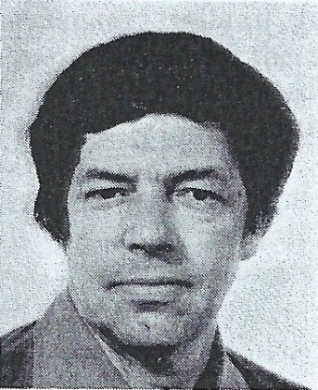
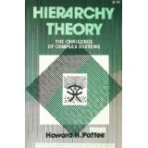

Syst. Sci. at Binghamton—Faculty
Howard Pattee:
  Stanford—Physics
  Our biological systems thinker, far
  ahead of his time
  His current Wikipedia article lists his
  fields as theoretical biology/origins of
  life/complex systems/artificial life/
  biosemiotics/biocybernetics/physics
  of codes/symbol systems
  Had following in our Biology Dept.

Slide 37
Syst. Sci. at Binghamton—Faculty
Joe Flannigan:
  Univ. of Illinois, Urbana-Champaign, Mathematics
  Also associate director of SRI-Manhattan & previously taught at Carnegie-Mellon
  Time at Binghamton brief, but influence significant
  Taught theoretical CS-type courses in a creative way
Jim Geer:
  NYU, Mathematical Physics
  Best represented applied math concentration of SAT & eventually transferred to Mechanical Engineering Dept.
  Interests centered on classical applied math—perturbation theory/fluid dynamics
  Taught mathematical modeling & optimization

Slide 38
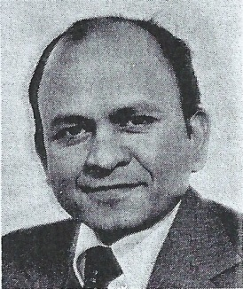
Syst. Sci. at Binghamton—Faculty
Narendra Goel:
  Univ. of Maryland, Mathematics
  More of a bio-mathematician and general applied mathematician than a bio-systems person
  Projects involved remote sensing & interest in protein folding
  Taught courses such as Prob. & Stats., Stochastic Systems
  Eventually left to teach at Wayne State
  Good example of spirit of teaching math
  well to people w/o math backgrounds
  I filled in for him in several sessions
  of the Prob. & Stats. Course when he
  was away on research

Slide 39
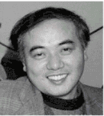
Syst. Sci. at Binghamton—Alumnus
Masahiko Higashi:
  Son of Kyoto artisans
  Studied biology and mathematics at Kyoto University
  Completed MS (1980) & PhD (1983) under George—with award-winning & highly mathematical dissertation
  Played a prominent role in founding the Faculty of Science & Technology (理工学部) at Ryukoku University
  Became Professor of Mathematical Ecology at Kyoto University 1994
  Died tragically with colleague on research trip in 2000
  “At the time of his death, he was considered the preeminent
  theoretical ecologist in Japan, having developed models of social
  Structure, sexual selection, and food webs, but his major
  contribution was a theory of the evolution of social behavior in
  termites.”*
  *Insecte Sociaux

Slide 40
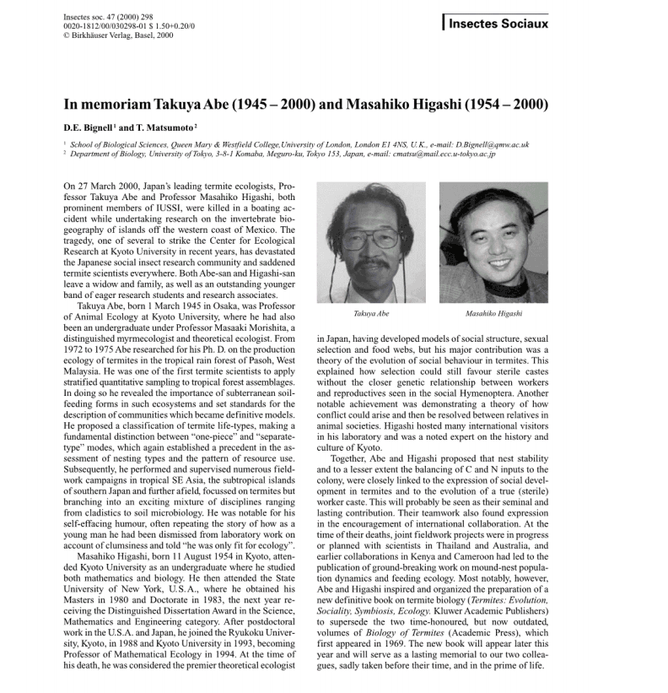
Syst. Sci. at Binghamton—Alumnus

Slide 41
Systems science in other locations
Portland State Systems Science Program
  Considered our sister program for a long time
  Some cross-fertilization, but not much
  Not an actual department & not part of any school
  Small number (3-4) of core faculty with larger numbers of joint (5-7) & adjunct (5-7) faculty
  Offer PhD, MS, two graduate certificate, & undergraduate minor programs
  Previously “used” for “departmental” (as opposed to “core”) PhDs

Slide 42
Systems science in other locations
Tokyo Institute of Technology
  Probably largest (18-25 faculty) systems science department in the world
  Site of a very interesting battle with sides led by Profs. Takahara & Sugeno
  Change of focus & of name: Dept. of Systems Science → Dept. of Computational Intelligence & Systems Science
  George (& I) have had significant long-term connections to both Takahara and Sugeno, but we’ve had no connections with the new generation

Slide 43
What has happened since then? ‘90s
At the start of the ‘90s, Binghamton’s SS Dept. outlook was guardedly optimistic, judged small (just barely critical mass) but stable department
But soon thereafter challenges began:
  Faculty approaching retirement age at time when NYS budgets were tight (gradual faculty shrinkage)
  Local industry was moving away (part-time student pool shrinking)
  Watson engineering graduate programs maturing (competition for those students remaining in that pool)
  (?) Fewer people willing to become full-time students w/o funding
  Only Watson department w/o undergraduate students
  Faculty continue to have divergent views on meaning of systems science & program still weak in sense of central focus
  George was sick to death of being chair & no one willing to step up

Slide 44
What has happened since then? ‘90s
At that time, Dept. of Mechanical & Industrial Engineering had two faculty members in IE field
In 1994, those two break off from that department and merge with SS to form SSIE Dept., with one of the two as chair
Why exactly that decision was made is an interesting question:

Slide 45
What has happened since then? ‘90s
For the 1st few years after the merge, separate rubrics (IE & SS) maintained for almost all the courses
But by 1996, all courses listed with SSIE rubric
More of SS faculty retire
1st chair of merged department eventually claims no faculty member can be allowed to list title as __ professor of SS or ___ professor of IE
Not yet an undergraduate program
Degrees offered MS-SS, MS-IE, & PhD-SS
PhD-SS “used” to offer equivalent of doctorate in IE under the Manufacturing Systems Concentration

Slide 46
What has happened since then? ‘90s
By the time I got here in 1998
  Original Sys. Sci. faculty who were still full-time pretty much down to just George Klir
  George was totally sick of all things administrative or political
  Idea had formed (championed mainly by Don Gause who was then a Bartle) to develop a Systems Engineering concentration under the Systems Science Programs
So, upon arriving here, (though not tenured) I became almost immediately:
  Coordinator for developing curriculum for SE concentration
  Graduate director for systems science
  Director of Center for Intelligent Systems
  The only one actively championing systems science

Slide 47
What has happened since then?
Center for Intelligent Systems (CIS) ORC
  In some ways parallel to CoCo
  Very multidisciplinary (geology, psychology, geography, philosophy, EE)
  Many multidisciplinary proposals
  Hosted about 10 seminars/semester—more than half by external speakers (including Glasersfeld)
  Despite so many connections to Harpur, Watson dean’s office was very territorial about it
  Worked very hard putting together an NSF-IGERT proposal centered around, only to have the Watson dean refuse to sign on the day of the deadline

Slide 48
What has happened since then?
PACCS Program in Philosophy, Computers, & Cognitive Science
  Quite connected to Systems Science & CIS
  Offered MAs & PhDs as concentration in philosophy
  Strong connections to psychology & CS depts. as well as Systems Science
  Eileen Way played a major role before moving over to systems science
  A few of their students tried to move over to systems science PhD
  I believed there was a benefit in emphasizing connections between cognitive sci. & systems sci.

Slide 49
What has happened since then? ‘00s
IE Program changes name to ISE (Industrial & Systems Engineering), should have taken over SE
BS-ISE degree starts
License eventually granted for PhD-ISE
Distinctions blurred, but ISE programs grow rapidly
Bioengineering Dept. starts originally planning to have a systems science-like focus, Don Gause plays role in planning, I try to find ways to collaborate
Systems Science degrees (both MS & PhD) “used” again while bioengineering waiting for degree license
Practice begins of “using” systems science degrees for students from non-engineering backgrounds who want to study ISE
Frequent confusion by students about distinctions in programs

Slide 50
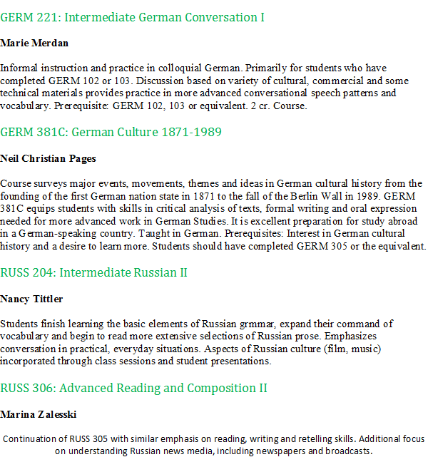
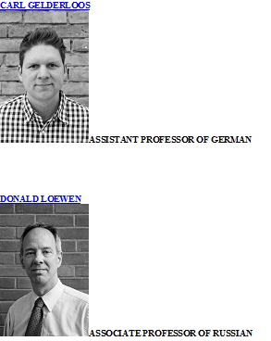
Personal reflections & possible lessons
There are other models of combined departments (e.g. Dept. of German & Russian Studies)

Slide 51
Personal reflections & possible lessons
Opinion: Systems science, complex systems (or systems studies under any other name) is a transdisciplinary field that is much more than just engineering-lite or “technical”
Maybe Portland State’s program has a better situation—not being a part of any school let alone a department
But if we assume it is unavoidable for Binghamton’s program to be part of the engineering school & even part of an engineering department, can it still try to have its own identity?
If two programs are merged into one department, there are multiple ways to do it, but what has evolved in the SSIE Dept. strikes me as absolutely 中途半端

Slide 52
Personal reflections & possible lessons
Perhaps in the face of organizational & other limitations of the SS Program, CoCo (or similar research center) might be the best way available to move systems studies ahead
Try to avoid letting administrators get territorial about it
General lesson: It is probably a mistake to let your program be used for purposes other than intended
General lesson: Having a program where people “do their own thing” is good in some ways, but having some degree of consensus on a central focus for a program is good too
General lesson: Academic people like to create new programs even at the expense of existing ones
General lesson: We can’t recreate the past & shouldn’t try, but we should understand the past
General lesson: Try to protect your identity/image

